Slide 1

EMI and USB filters
安 森 美 半 导 体

Slide 2

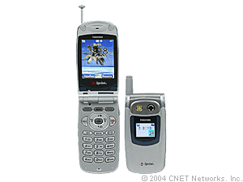

EMI filters in Handset Applications
LCD Display
Operating Voltage 4.0 to 5.0 Volts
Clock speed: 13 to 20 MHz
# of data lines: 16 to 24 lines
Microphone /Speaker
Operating Voltage: 3.0 to 5.0 Volts
# of lines: 3 to 4 lines
Key Pad
Operating Voltage: 2.7- 3Volts
# of data lines: 16 to 24 lines
Mega Pixel Camera/
Flash Modules
Operating Voltage: 2.5 to 3.0 Volts
Clock speed: 27 MHz
# of data lines: 16 to 24 lines
Bottom Connector /
USB1.1 Interface
Operating Voltage: 2.7- 5Volts
# of data lines: 10 to 20 lines
SIM and MMC Interface
Operating Voltage: 2.7- 5Volts
Clock speed: 13 to 34 MHz
# of data lines: 3 or 4 lines

Slide 3
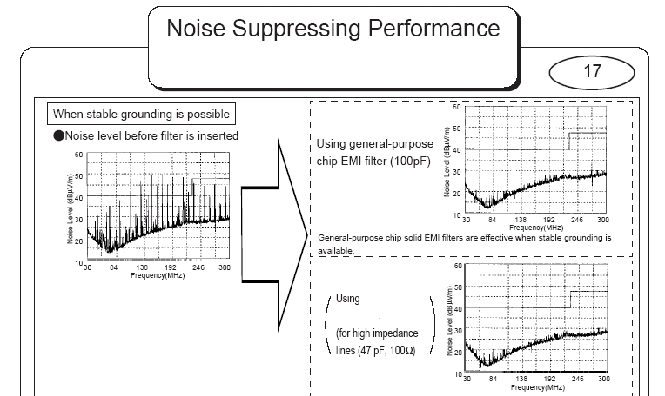
How EMI filter functions
10 mHz Clock for DC signal line

Slide 4
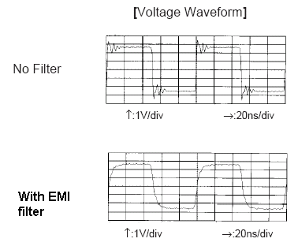
How EMI filter functions

Slide 5

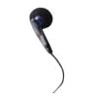
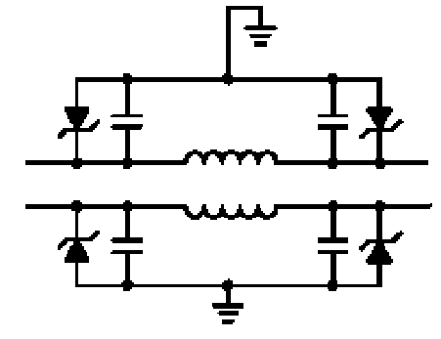
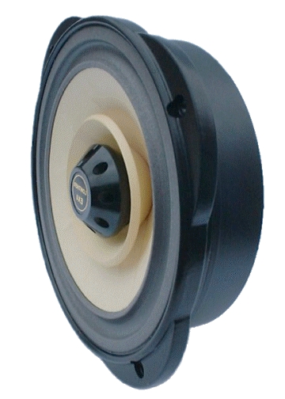
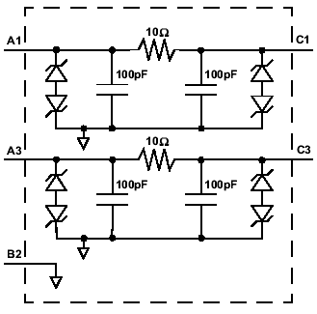

Audio/ Speaker Line
NUF2441FCT1(Available Jun’04)
EMI Filter with ESD Protection
Inductors Integrated 3.5nH
Low Resistance 0.32ohm Integrated
Package: Flip-Chip
Audio processing and conversion
A
OR
Speaker
D
Benefits:
Peak Current 2 amps
Ui-Directional EMI Filtering Low Power Loss by Integrated Inductors
Replace 12 discrete components
ESD Immunity as per IEC61000-4-2 Level 4
OR
NUF2113FCT1(Available Q3’04)
EMI Filter with ESD Protection
Low Resistance 10ohm Integrated
Package: Flip-Chip
Audio processing and conversion
Benefits:
Bi-Directional EMI Filtering Prevents Noise from Entering/Leaving the System
Low Power Loss by Integrated Low Resistance
Replace 14 discrete components
ESD Immunity as per IEC61000-4-2 Level 4
A
OR
Speaker
D

Slide 6
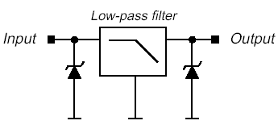

Bottom Connector
NUF9001FCT1G
10 Channel EMI Pi-Filter with ESD Protection
Two Bump Sizes Available
  300μm & 350μm
Package: Flip-Chip
NUF9001FC
Controller
Benefits:
Low PCB area (2.6mm x 2.6mm)
Reduced components count
Low line capacitance for high data rate exchange
NUF4105FCT1; NUF6105FCT1; NUF6106FCT1(20pF@2.5V)
4 & 6 Channel EMI Pi-Filter with ESD Protection
Two Bump Sizes Available
  300μm(PB) for NUF4105FC and NUF6105FC
  350μm(PB-free) for NUF4115FC and NUF6115FC
Package: Flip-Chip
NUF6105/6106
NUF4105
Controller
Benefits:
Low PCB area
Reduced components count
Wide freq. range rejection -35dB from 800MHz to 2.2GHz
Low line capacitance for high data rate exchange

Slide 7
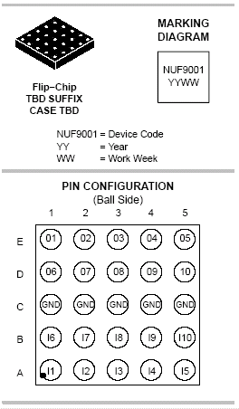
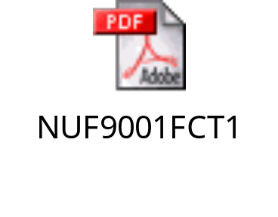
NUF9001FCT1 –10 channel EMI filter
Description
This device is a 10 line EMI filter array for wireless applications. Greater than -35 dB attenuation is obtained at frequencies from 800 MHz to 2.2 GHz. It also offers ESD protection – clamping transients from static discharges. ESD protection is provided across all capacitors.
Features
EMI Filtering and ESD Protection
10 line in Flipchip
Moisture Sensitivity Level 1
Applications
Wireless Phones
Handheld Products
LCD Displays
Schedule
Phase 0 approved Approved
Engineering Sample Now
Production Now

Slide 8
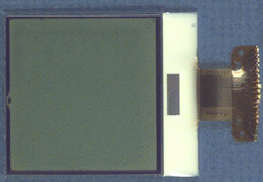
LCD Display
NUF4401 or NUF4402
NUF4401MNT1,NUF4402,NUF8401 (Available Jul’04)
4 and 8 Channel EMI Pi-Filter with ESD Protection
100/200 Ohms line resistor design for LCD application
Package:
NUF4401: 2X2mm QFN package
NUF4402: 1.6X1.6mm QFN package
NUF8401: 1.6X4.0mm QFN package
Controller
NUF4105FCT1; NUF6105FCT1; NUF6106FCT1 (20pF@ 2.5V)
4 & 6 Channel EMI Pi-Filter with ESD Protection
Two Bump Sizes Available
  300μm for NUF4105FC and NUF6105FC
  350μm for NUF4115FC and NUF6115FC
Package: Flip-Chip
NUF4105/15
NUF8401
Benefits:
Low PCB area
Reduced components count
Wide freq. range rejection -35dB from 800MHz to 2.2GHz
Low line capacitance for high data rate exchange
Controller

Slide 9
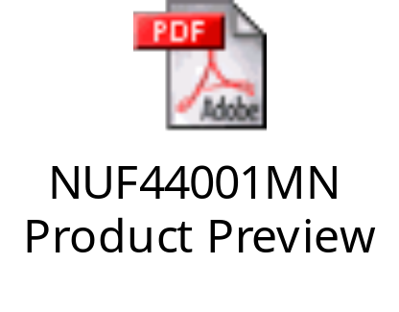
NUF4401MN(2.0MM)
4 Channel EMI filter
Description
This device is a 4 line EMI filter array for wireless applications. Greater than -35 dB attenuation is obtained at frequencies from 800 MHz to 2.2 GHz. It also offers ESD protection – clamping transients from static discharges. ESD protection is provided across all capacitors.
Benefits
Reduces EMI/RFI Emissions on a Data Line
Integrated Solution offers Cost and Space Savings
Reduces Parasitic Inductances Which Offer a More “Ideal” Low Pass Filter Response
Integrated Solution Improves System Reliability
Features
EMI Filtering and ESD Protection
QFN 2x2mm
Moisture Sensitivity Level 1
Applications
Wireless Phones
Handheld Products
LCD Displays
Schedule
Phase 0 approved
Engineering Sample May 2004
Production Q2 2004

Slide 10
New product 1 pager
NUF4402MN(1.6X1.6MM)
4 Channel EMI filter
Description
This device is a 4 line EMI filter array for wireless applications. It also offers ESD protection – clamping transients from static discharges. ESD protection is provided across all capacitors.
Benefits
Reduces EMI/RFI Emissions on a Data Line
Integrated Solution offers Cost and Space Savings
Reduces Parasitic Inductances Which Offer a More “Ideal” Low Pass Filter Response
Integrated Solution Improves System Reliability
Features
EMI Filtering and ESD Protection
QFN 1.6x1.6mm
Moisture Sensitivity Level 1
Capacitance target 30pF @ 0 Volts
Rstarget 100 Ohms
Applications
LCD Displays
Wireless Phones
Handheld Products
Schedule
Phase 0 approved
Engineering Sample Aug 2004
Production Sep 2004

Slide 11
New product 1 pager
NUF8401MN(1.6X4.0mm) 8 Channel EMI filter
Description
This device is a 8 line EMI filter array for wireless applications. Greater than -35 dB attenuation is obtained at frequencies from 800 MHz to 2.2 GHz. It also offers ESD protection – clamping transients from static discharges. ESD protection is provided across all capacitors.
Features
EMI Filtering and ESD Protection
QFN 1.6x4.0mm
Moisture Sensitivity Level 1
Capacitance target 30pF @ 0 Volts
Rs target 100 Ohms
Applications
LCD Displays
Wireless Phones
Handheld Products
Schedule
Phase 0 approved
Engineering Sample Aug 2004
Production Sep 2004

Slide 12
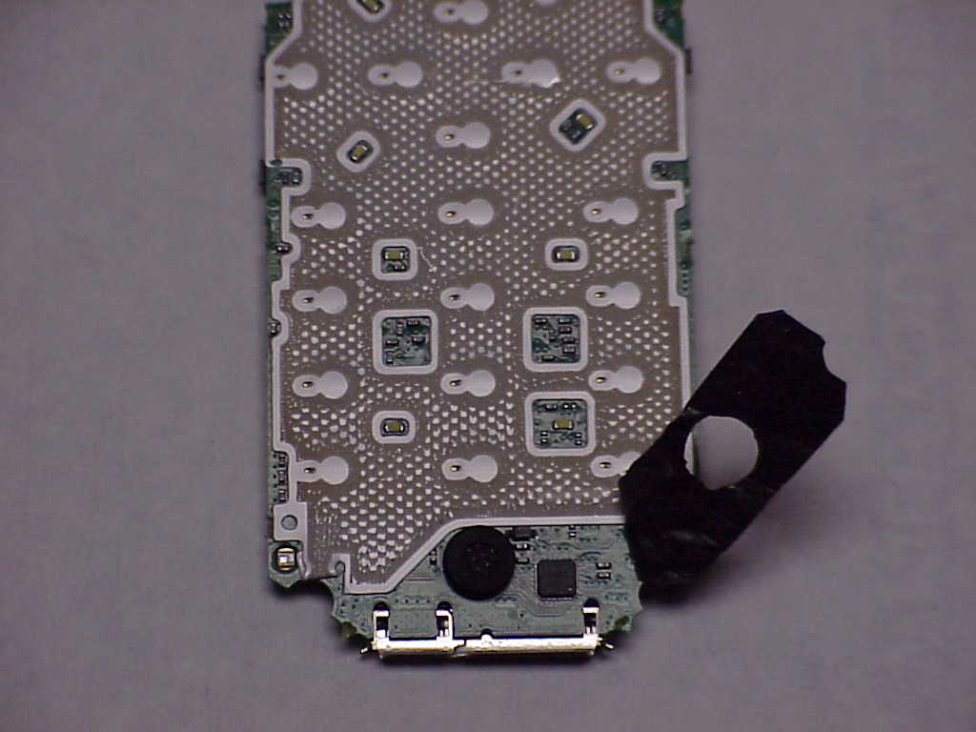

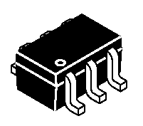
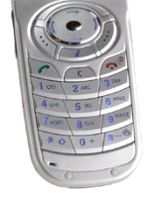
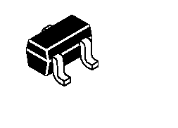
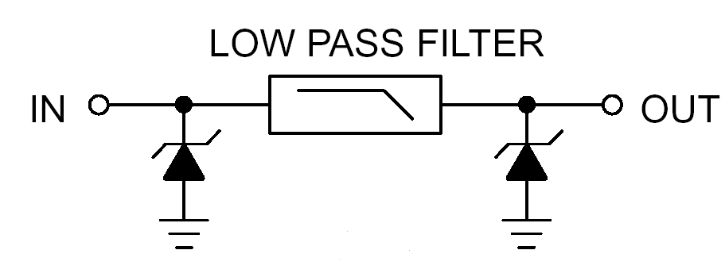
Keypad
NZMM7V0T4
9 EMI/RFI+3 ESD diodes Directional “Pi” Low Pass Filter
4 x 4 mm Lead Less MLF Surface Mount Package
Replace 30 discrete components
Package: 24 PIN MLF
NZF220DFT1
Dual EMI/RFI Bi–directional “Pi” Low–Pass Filters
Package: SC-88A
NZF220TT1
Single EMI/RFI Bi–directional “Pi” Low–Pass Filters
Package: SC-75
I1
I2
O1
I3
O2
O3
ON’s Filter
CPU
O7
I7
O8
O9
Benefits:
Suppresses EMI/RFI Noise in Systems Subjected to Electromagnetic Interference
Small Package Size Minimizes Parasitic Inductance, Thus a More “Ideal” Low Pass Filtering Response
I8
I9

Slide 13
Mega pixel Camera Interface
& High speed dataline
NUF6106FCT1 (20pF@ 2.5V) with 100 Ohms
NUF6107FCT1( 20pF@ 2.5V) with 30 Ohms
6 Channel EMI Pi-Filter with ESD Protection
Low Capacitance (20pF@2.5V) for Mega pixel/ high speed dataline
Package: Flip-Chip
CAMERA/Flash Module
Controller
Benefits:
Low PCB area
Reduced components count
Wide freq. range rejection -25dB from 800MHz to 2.2GHz
Low line capacitance for high data rate exchange
NUF6106FC
NUF6107FC

Slide 14
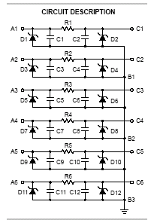
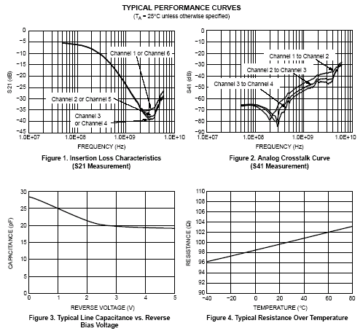
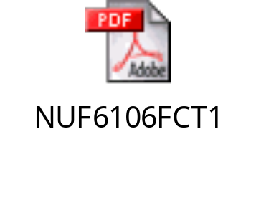
NUF6106FCt1 –Low capacitance 6 channel EMI filter for high speed

Slide 15

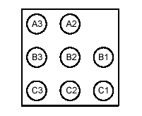
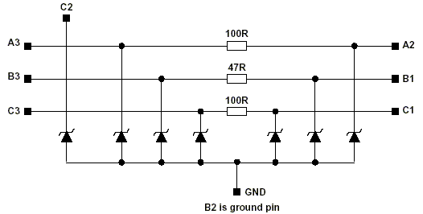
SIM Card Interface
NUF3101FCT1(Available in Jul 04)
Integrated Filter with ESD Protection
3 channels are dedicated to data lines
and 1 channel is for the supply voltage
Package: Flip Chip (1.6X1.6mm)
Vcc
SIMDATA
in1
out1
SIMCLK
in2
out2
SIMRST
in3
out3
NUF3101FCT1

Slide 16
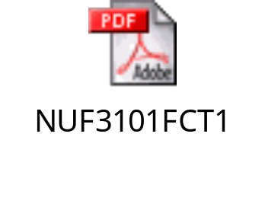
NUF3101FCT1
SIM card EMI filter
Description
This device is a 3 line EMI filter array with TVS diode design for SIM card application. Greater than -35 dB attenuation is obtained at frequencies from 800 MHz to 2.2 GHz. It also offers ESD protection – clamping transients from static discharges. ESD protection is provided across all capacitors.
Features
EMI Filtering and ESD Protection
Flipchip
Moisture Sensitivity Level 1
Applications
Wireless Phones
Handheld Products
LCD Displays
Schedule
Phase 0 approved
Engineering Sample Now
Production Jun 2004

Slide 17
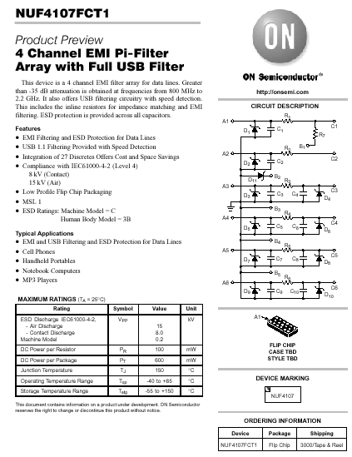

USB filter
+
4 Channel
EMI filter
Schedule
Engineering Sample NOW
Production NOW

Slide 18
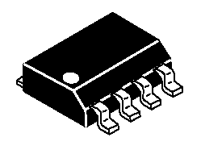
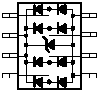


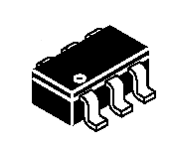
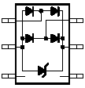
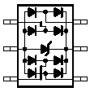
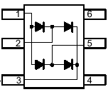
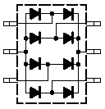
USB Portfolio for ESD Protection
USB
1 Lines
(1/2 Port)
2 Lines
(1 Port)
4 Lines
(2 Port)
USB 1.1
I/O Lines
+
V_{Bus}
USB1.1
SOT-23
SO-8
SO-8
SL05
LC03-6
SRDA05-4
USB2.0
USB 2.0
I/O Lines
+
V_{Bus}
SO-8
NUP4201DR2
TSOP-6
NUP2201MR6
NUP4201MR6
TSOP-6
USB
I/O Lines
SOT-23
SC-88
TSOP-6
NUP1301ML3
NUP2301MW6
NUP4301MR6

Slide 19
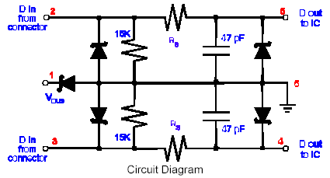
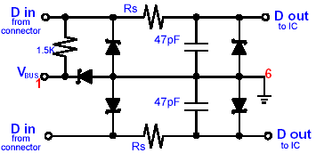
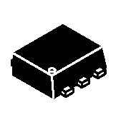
USB Portfolio for ESD/EMI Filter
USB1.1
Downstream Filter
Upstream Filter
USB 1.1
ESD
(I/O Lines)
+
V_{Bus}
+
EMI
(Filter)
NUF2101MT1
STF202-22
TSOP-6
TSOP-6
NUF2101MW6
NUF2221W1T2
SC-88
SC-88
NUF2101XV6
NUF2221XV6
Introduced
SOT-563
SOT-563
Under
Develop
Proposal

Slide 20
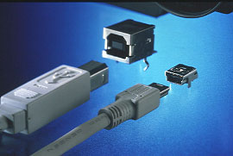
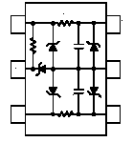
USB Interface
NUF2221W1T2; STF202-22
2 Line Termination, EMI Filtering and
ESD Protection for Upstream USB Port
Integrated Pull-up Resistor
VCC Protected by Integrated Clamping Diode
Package: SC-88 (for NUF2221)
TSOP-6 (for STF202)
Peripheral (Upstream)
Vcc
NUF4107FCT1G
4 Channel EMI Filtering with ESD Protection for Data Lines(1.33X3.0mm)
USB 1.1 Filtering
Flip-Chip Package
  300μm
  350μm
NUF2221 & STF202
Vbus
USB D+
NUF4107FC
In+
Vbus
out+
USB D-
In-
out-
D1
in1
out1
Benefits:
IEC61000-4-2 Level 4, ESD Protection
Small PCB space (1.2 x 1.7 mm²)
Up to 27 discrete components replaced
D2
in2
out2
D3
in3
out3
D4
in4
GND
out4

Slide 21
New Products Roadmap

Slide 22







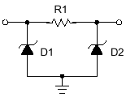
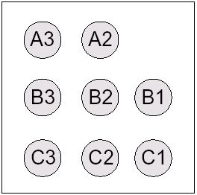
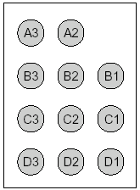

EMI Filters
Flip Chip
Package
Introduced
NUF4105
4 channel filter+ 4 TVS diode
NZF220T/NZF220D
Single(SC-75)/ Dual filter(SC-88A)
2004
NUF4107
4 channel filter +USB filter
2005
NZMM7V0
9 channel filter MLF24 pin
24 PIN MLF
4X4mm
2006
NUF6105
6 channel filter
NUF4401MN
4 channel filter 2mm QFN
NUF6106 (Low-cap)
6 channel filter
8 pin QFN
2X2mm
NUF4402MN
4 channel filter 1.6mm QFN
NUF9001
10 channel filter
NUF8401MN
8 channel filter 1.6X4mm DFN
8 pin QFN
1.6X1.6mm
NUF3101
SIM Card filter
NUF4404MN (Low-cap)
4 channel filter 1.6mm QFN
NUF3201
MM Card filter
NUF4801MN (Low cap)
4 channel filter/ 4 ESD diode 1.6X4mm DFN
NUF9002 (Low-Cap)
10 channel filter
NUF1001MN (Low-cap)
10 channel filter/4 ESD diode 1.6X5mm DFN
16 pin DFN
1.6X4.0mm
NUF1602 (Low-Cap)
12 channel filter

Slide 23

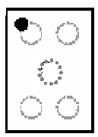

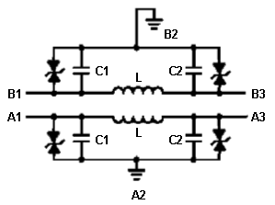
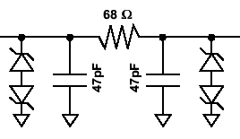
Audio Filters
Flip Chip
Package
Introduced
NUF2441FC
2 channel LC Speaker/Headset filter
NUF4111 MN
4 channel Speaker and Mic RC+LC Filter in 2mm QFN
8 pin QFN
2X2mm
2004
2005
NUF2113FC
2 channel Headset RC filter
NUF4112MN
4 channel Speaker and Mic RC+ LC Filter in 1.6mm QFN
8 pin QFN
1.6X1.6mm
2006
NUF2114FC
2 channel Mic RC filter
NUF4112FC
3 channel Speaker and Mic RC Filter
RC Filter
LC Filter

Slide 24
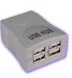
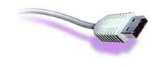

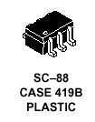

USB Filter/ESD protection
Downstream Filter
Upstream Filter
Case Outline
Introduced
CIRCUIT
DESCRIPTION
2004
2005
2006
NUF2101MT1 TSOP- 6
STF202-22
TSOP- 6
NUF2221W1 SC-88
USB 1.1
USB OTG
NUF2101XV6
SOT-563
NUF2221XV6
SOT-563
NUF2101FC
Flip-Chip
NUF2222FC
Flip-Chip
NUP2201MR6
TSOP- 6
NUP4201MR6
TSOP-6
USB 2.0
NUP2201VX6
SOT-563
NUP4201XV6
SOT-563
Flip-Chip 1.2X1.8mm

Slide 25
Thank You
Hyung Kim
Email: h.kim@onsemi.com
Tel# 602-244-4857

